Slide 1
SAGE
Designing for an Active Transition into a Retirement Lifestyle
Adam Barry, Amy Chang, Ethan Hellman, Brendan McLoughlin
CS 147 · F23 · Stanford University

Slide 2

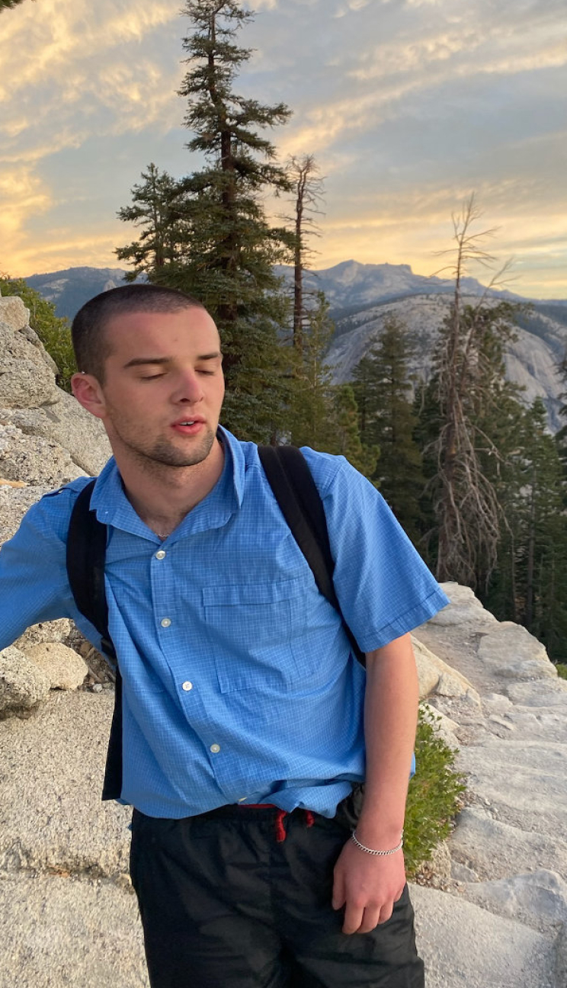
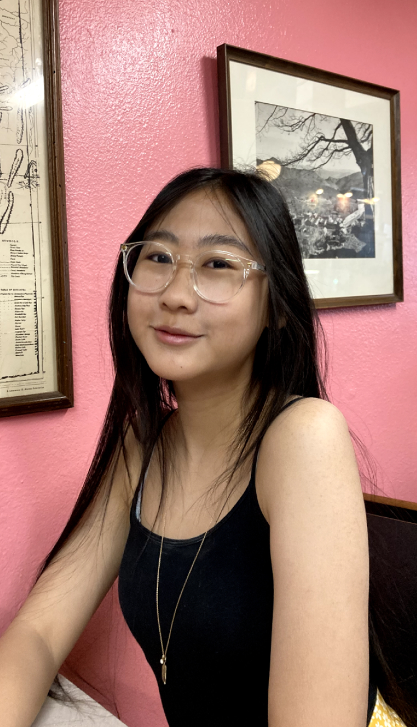
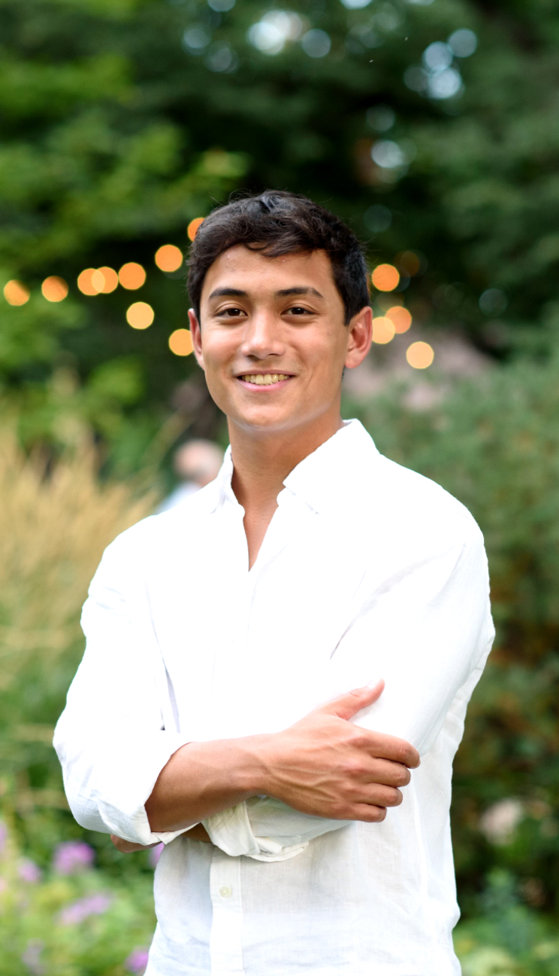
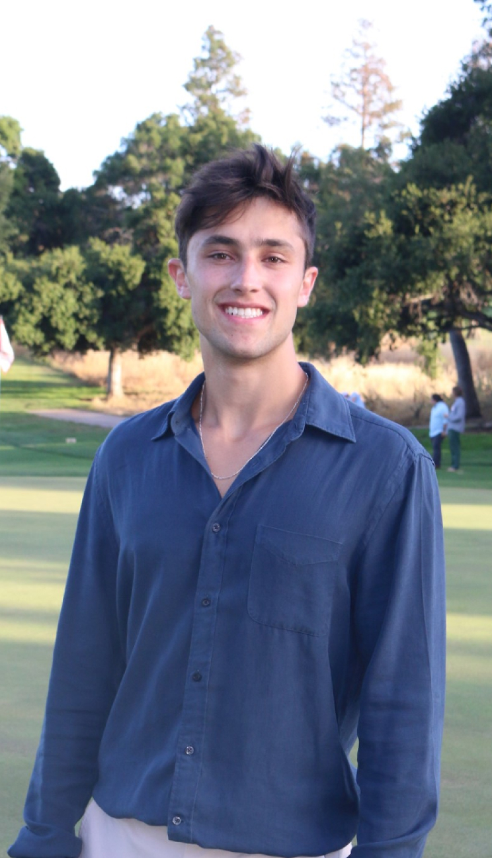
Team
Name: Adam Barry Year: Junior Major: Computer Science (HCI)
Name: Amy Chang Year: Junior Major: Computer Science (HCI)
Name: Ethan Hellman Year: Senior Major: Computer Science (AI)
Name: Brendan McLoughlin Year: Senior Major: Computer Science (HCI)

Slide 3
Name Selection

Slide 4

Name Selection
Consider needs & solution
NEEDS
Create sense of purpose
Prevent loneliness
SOLUTION
Facilitate creation of shared gardens that donate their harvest.

Slide 5
Name Selection
Brainstorm names

Slide 6
Budding Buddies
Nourish
Group Sprouts
Plant Club
Stamen
Bloomly
FloraFolk
Greenly
Verdant
Plant Pet
Cultivate
Harvest
Sage
Vinelink
Flourish
MoreSprouts
Planda
Thrive
Sepal
Blossom
Sproutly
OneSprout
WeGarden
Friend Gardens
Garden Grannies
GreenGather

Slide 7




Budding Buddies
Nourish
Group Sprouts
Plant Club
Stamen
Bloomly
FloraFolk
Greenly
Verdant
Symbolizes wisdom
Plant Pet
Cultivate
Harvest
Sage
Vinelink
Evokes feelings of health and nature
Flourish
MoreSprouts
Sonically appealing, concise
Planda
Thrive
Sepal
Blossom
Sproutly
OneSprout
WeGarden
Friend Gardens
Garden Grannies
GreenGather

Slide 8


VALUE PROP
Creating newfound purpose and friendships through gardening

Slide 9
Problem & Solution

Slide 10

Problem & Solution
Back to our POV
WE MET
WE WONDER IF THIS MEANS
Mary-Lue Timpson (MLT), an 80-year-old who volunteers at Senior center
Feels different from other seniors due to role in the community which gives her a greater sense of purpose.
WE WERE SURPRISED TO LEARN:
IT WOULD BE GAME-CHANGING TO
MLT considers herself separate from the other seniors.
Deliver a similar sense of purpose through responsibility to more people.

Slide 11

Problem & Solution
Back to our POV
WE MET
THE GREATER PROBLEM
WE WONDER IF THIS MEANS
Elderly people who lack community and contribution to something > than self often encounter feelings of loneliness and meaninglessness
Mary-Lue Timpson (MLT), an 80-year-old who volunteers at Senior center
Feels different from other seniors due to role in the community which gives her a greater sense of purpose.
WE WERE SURPRISED TO LEARN:
IT WOULD BE GAME-CHANGING TO
MLT considers herself separate from the other seniors.
Deliver a similar sense of purpose through responsibility to more people.

Slide 12
Problem & Solution
Back to our HMW
Utilize gardening as a means of bringing together elderly people who desire a sense of community & purpose.

Slide 13
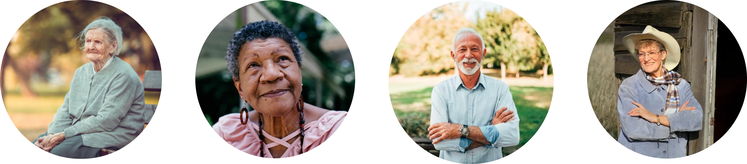
Problem & Solution
Primary User
Our primary user is an elderly adult, who is inactive or semi-active either socially or physically.

Slide 14

Problem & Solution
Original Solution
1.
2.
3.
Sage mails you a packet of seeds
Join a shared digital garden w/ friends
Update your plant's progress and watch as your community garden comes to life.

Slide 15

Problem & Solution
Revised Solution
.... to emphasize in-person activity
2.
3.
Select a physical community garden
Attend gardening sessions with friends working towards harvest goals
Donate fruits of labor to community causes

Slide 16
Market Research

Slide 17
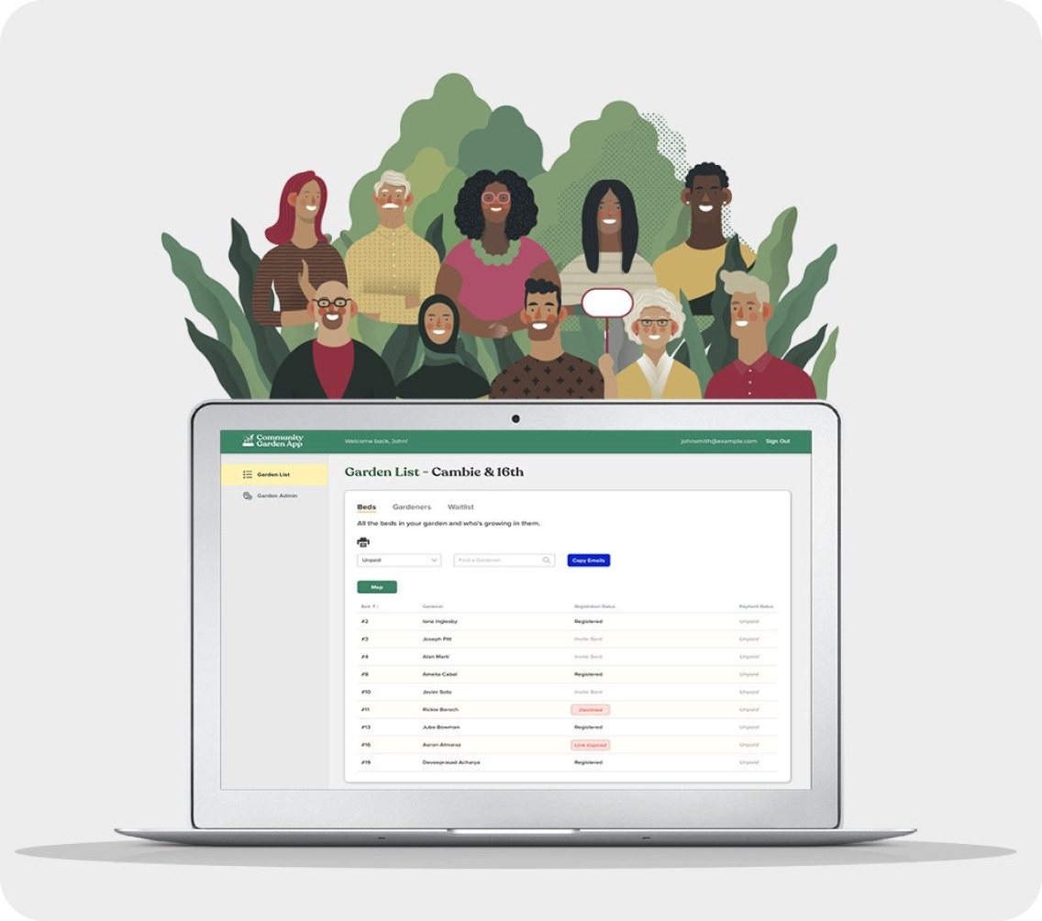

Community Garden Builders
PROS
CONS
Established for a decade
Temporary projects
Utilizes vacant land
Canada-based only
Digital tools for managers
Not elderly-focused

Slide 18
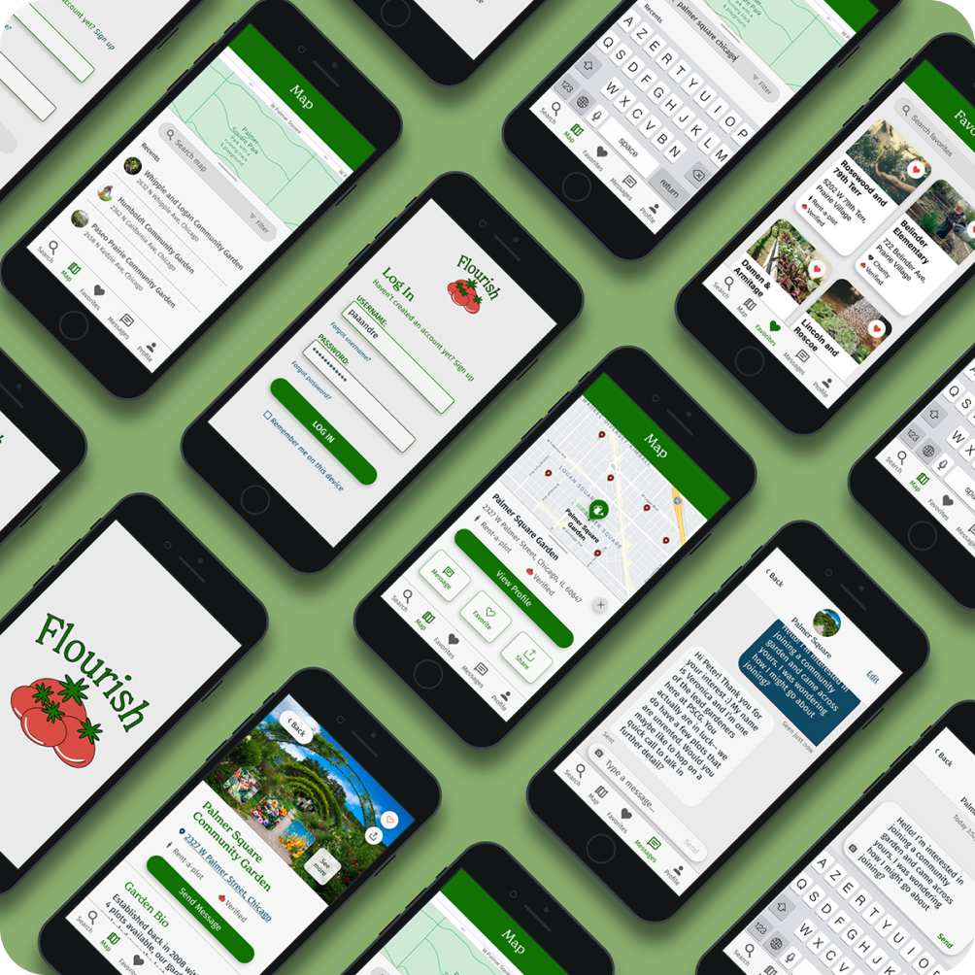

PROS
CONS
Connects organizers and volunteers
Not elderly-specific
User-tested
Limited accessibility
Simple design
Weak community feel

Slide 19


AARP Now APP
PROS
CONS
Rich Information
Impersonal
Diverse activities
Regional, non-recurring events
Built on AARP infrastructure
Clutter interface

Slide 20

Existing Groups (e.g., Wednesday Knitting Group)
PROS
CONS
No tech neeeded
Word of mouth communication
Human touch
Unstructured activities
Open to all
Hard to discover

Slide 21

Market Research
Opportunities
User-Friendly Tech: Enhance communication and event discovery with easy-to-use technology Community Focus: Strengthen community bonds and friendships through regular, local events Elderly-Centric Design: Ensure accessibility and usability tailored for the elderly Permanent Gardens: Provide stable, long-term gardening spaces for socialization and cultivation Community Contribution: Integrate opportunities for giving back through gardening initiatives

Slide 22
Values in Design

Slide 23
Values in Design
Stakeholders
Direct Elderly people Receivers of donated produce
Indirect Families, Eldercare workers Other users of community garden space

Slide 24
Values in Design
Ethical Implications
Tarot Card: Mother Nature
Tarot Card: The Scandal
Sage promotes eco-friendly gardening + education for sustainability Endemic plants = no invasive species. Consider ecological effects on wider community
Elderly users as scam victims during donation process Vetting processes? Partnering with known orgs. to mitigate this risk?

Slide 25
Tasks

Slide 26
Tasks

Slide 27
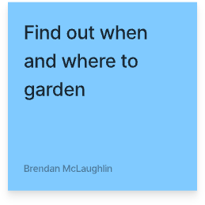
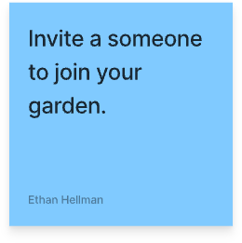
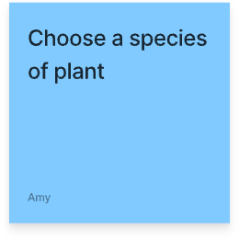
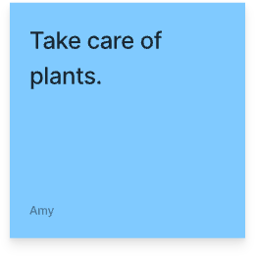
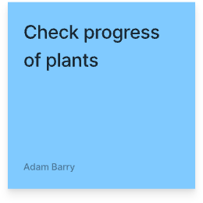


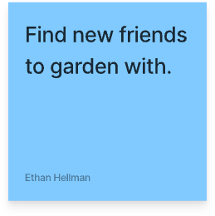
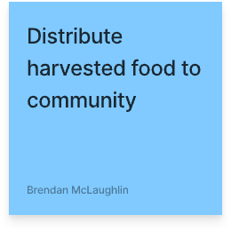
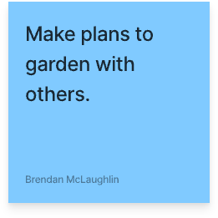
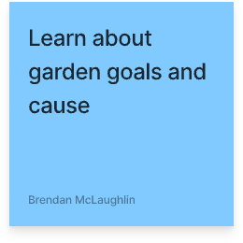

Tasks
MODERATE
COMPLEX

Slide 28


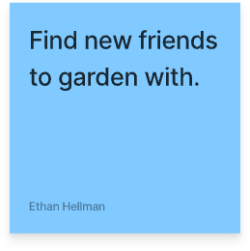

Tasks
MODERATE
COMPLEX

Slide 29
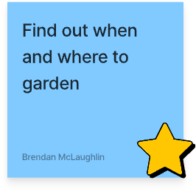
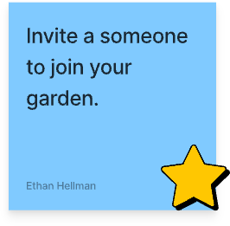


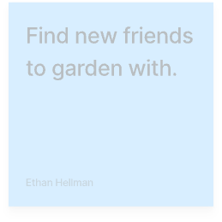





Tasks
SIMPLE
MODERATE
COMPLEX
Essential actions: 90% of users doing this 90% of the time
One step processes

Slide 30




Tasks
SIMPLE
MODERATE
COMPLEX
Essential actions: 90% of users doing this 90% of the time
One step processes

Slide 31

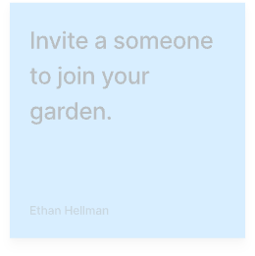


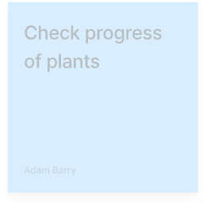




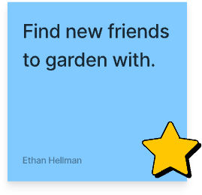
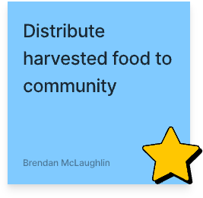
Tasks
SIMPLE
Requires Coordination with out-group individuals / orgs
Less frequent actions / power users
MODERATE
COMPLEX

Slide 32
Tasks
SIMPLE
Requires Coordination with out-group individuals / orgs
Less frequent actions / power users
MODERATE
COMPLEX

Slide 33
Video Storyboards

Slide 34
Video Storyboards

Slide 35
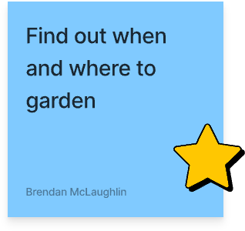
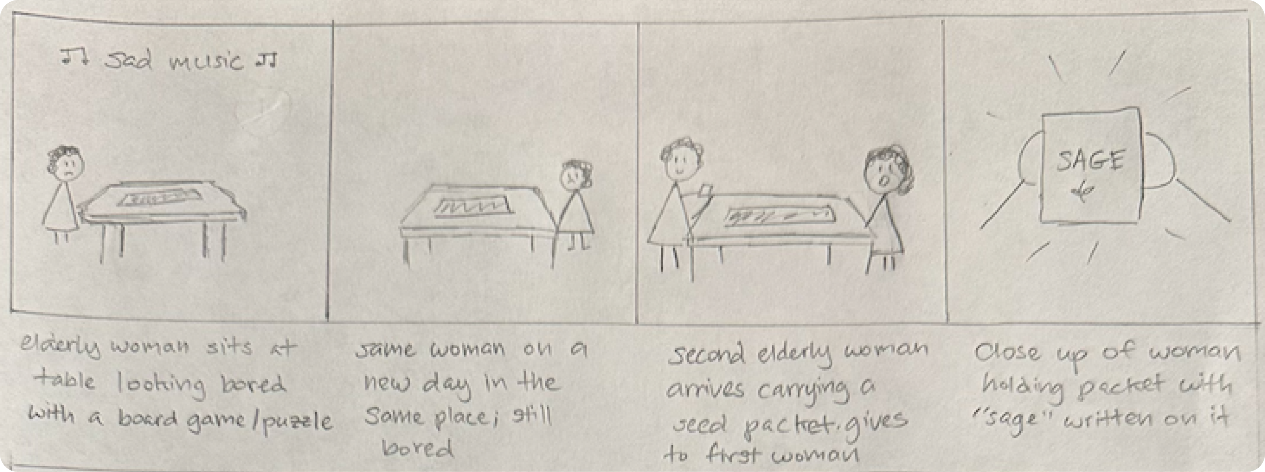
Find out when and where to garden

Slide 36

Find out when and where to garden

Slide 37
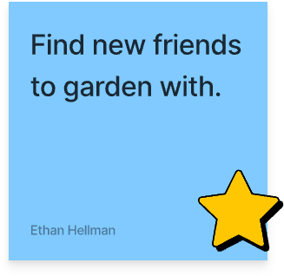
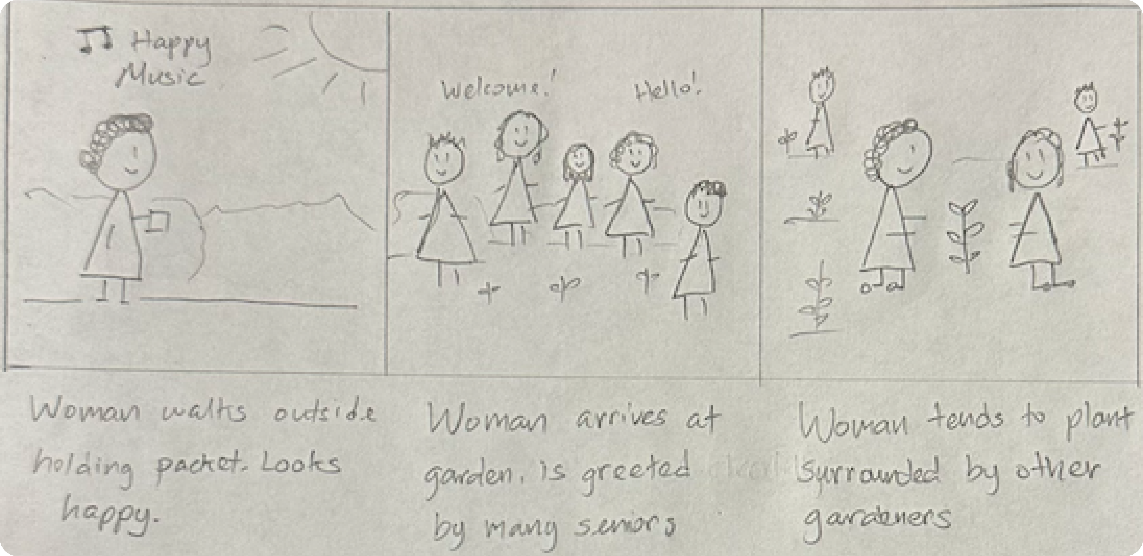
Find New Friends to Garden With

Slide 38

Find New Friends to Garden With

Slide 39
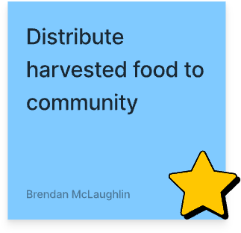
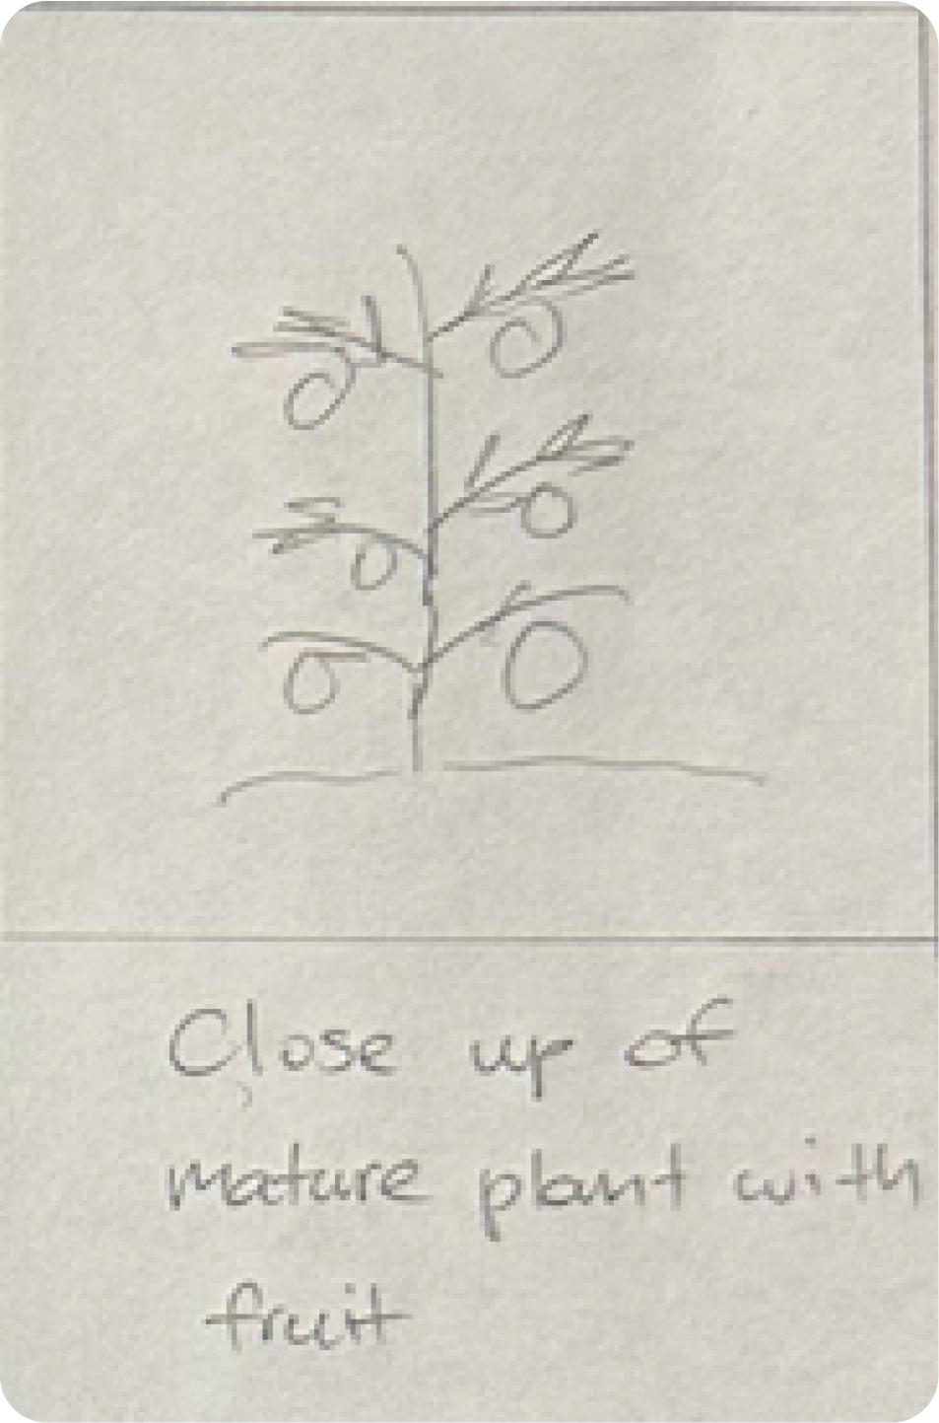
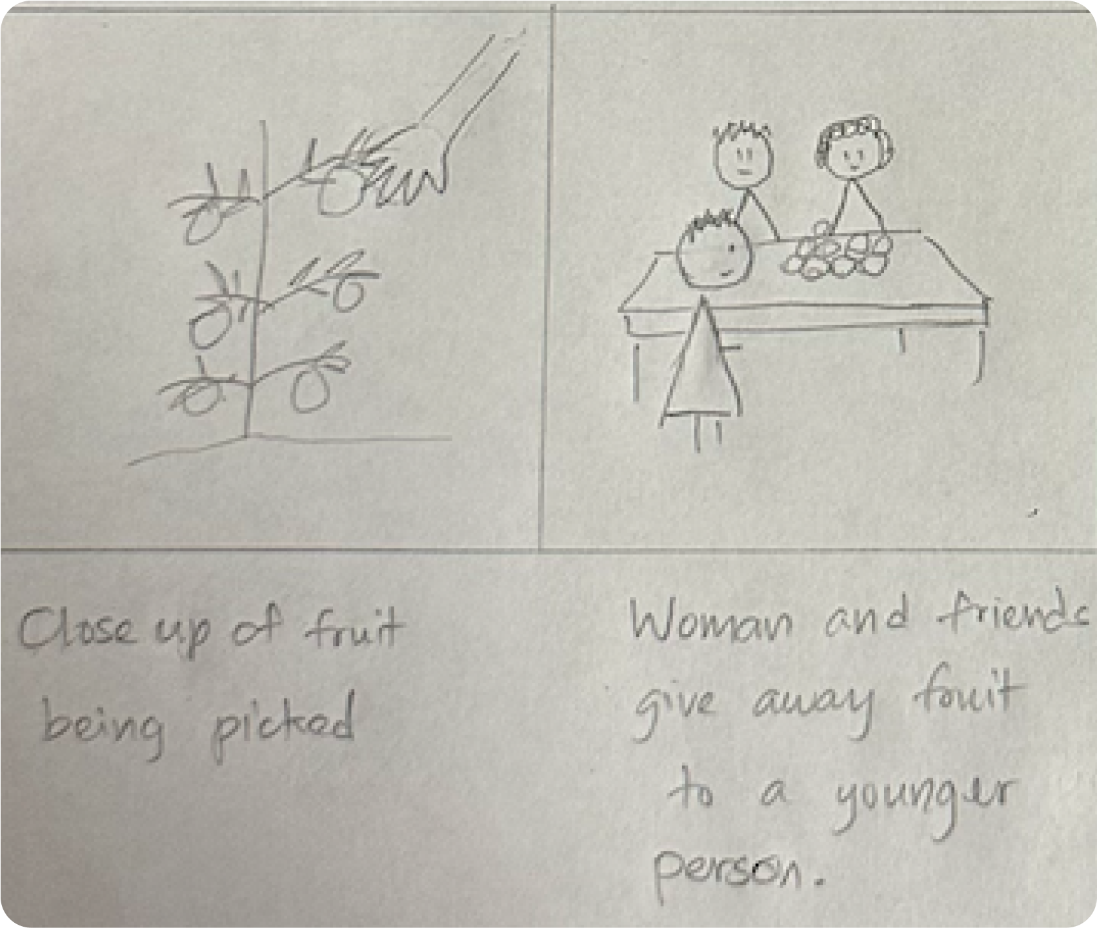
Distribute Harvested Food to Community

Slide 40

Distribute Harvested Food to Community

Slide 41
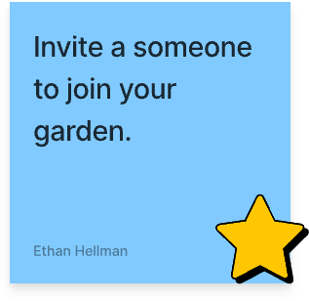
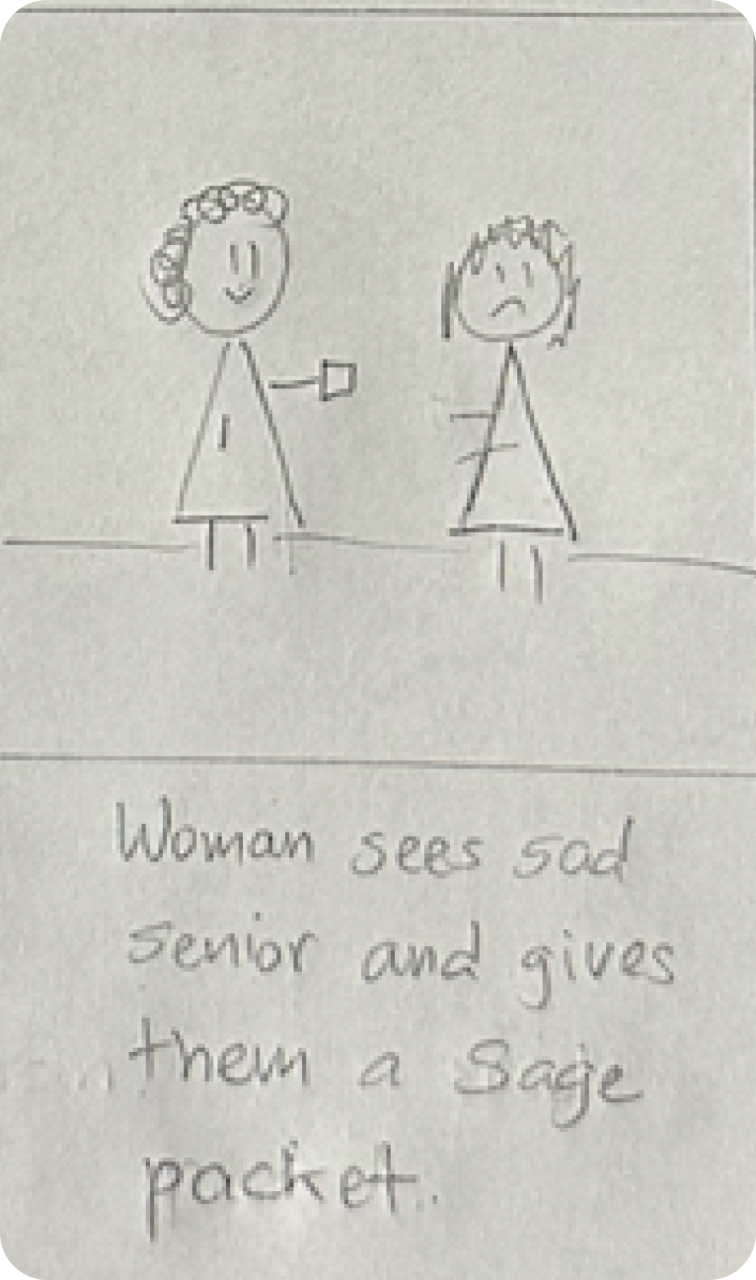
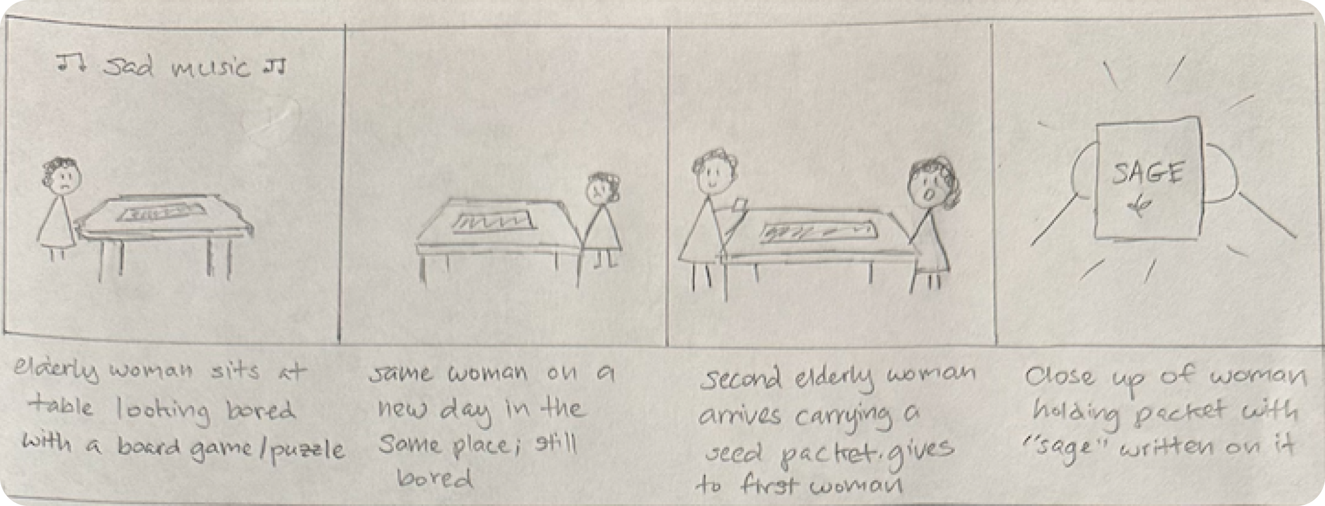
Invite Someone to Join your Garden
&

Slide 42

Invite Someone to Join your Garden
&

Slide 43
Concept Video

Slide 44
Concept Video

Slide 45
Thank you!

Slide 46
Thank you!

Slide 47
Appendix
Solution & Name Ideation
Task Brainstorm
Stakeholders & Ethical Implications
Market Research
Concept Video Design

Slide 48
Appendix
Solution & Name Ideation
Task Brainstorm
Stakeholders & Ethical Implications
Market Research
Concept Video Design
Interview Segment 1
Interview Segment 2

Slide 49
